Slide 1
Student Engagement Monitoring
David Guetta Industries
Brynn Ehni, Ruiming Liu, Randall Lueck, Carlo Mencarelli, Rayden Soriano IST-718, Section 2, Summer 2018

Slide 2


Who Are Oui?
Five students dedicated to empowering online learners through education technology.
Focus on marketing, admissions, student success, and outcomes support.
This Photo by Unknown Author is licensed under CC BY-NC-ND

Slide 3
Project Focus
This project aims to use facial recognition to identify the attendees in the recordings of the IST-718 Section 2 class, and to determine a student’s engagement using emotion recognition. The final product will be a comparative report using our in-house face and emotion recognition against a product out for purchase (i.e. Azure), and provide a cost-benefit analysis.

Slide 4

Student Retention Variables
Attendance
Engagement
This Photo by Unknown Author is licensed under CC BY-NC

Slide 5
Previous Studies
In a report by Fredericks et al. entitled “School Engagement: Potential of the Concept, State of the Evidence,” current classroom monitors focus on three key aspects to ensure student engagement in the classroom.
Student self-report questionnaires
Teacher reports on students
Observational measures

Slide 6
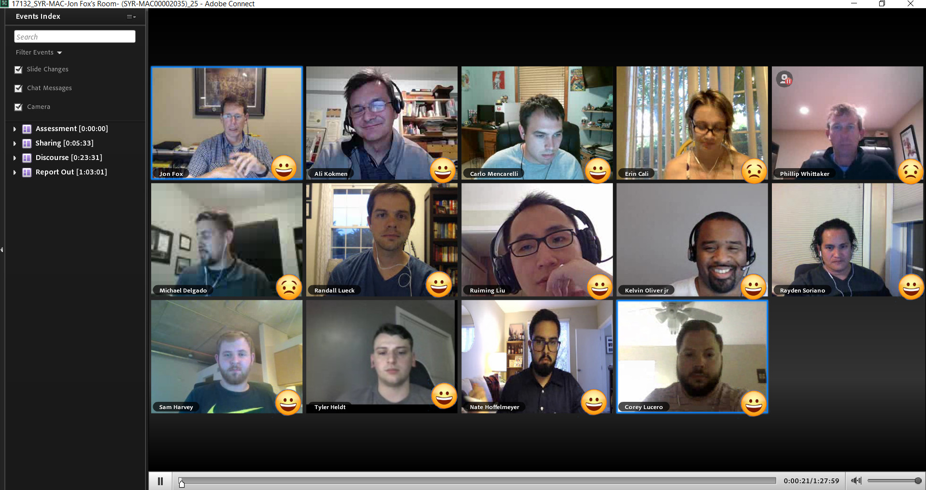
Emotion Recognition

Slide 7
Engagement Over Time
Place holder for graph

Slide 8
Sources
Recordings of IST-718 Section 2 class as the testing and training dataset.
Cohn-Kanade Emotion Database (http://www.consortium.ri.cmu.edu/ckagree/)
CMU Face Images Dataset available through University of California Irving (http://archive.ics.uci.edu/ml/datasets/cmu+face+images).
Fredericks, Jennifer A. et al. “School Engagement: Potential of the Concept, State of the Evidence.” Review of Educational Research, Vol. 74, No. 1 (Spring, 2004), pp. 59-109.

